Slide 1
TA 111: Technical Arts
2023-24 II
Lecture 24
Development of Surfaces- II
Dr. Syam Nair
Department of Civil Engineering
IIT Kanpur
Office: FB 307
Phone: 6424
Email: syamnair@iitk.ac.in

Slide 2
Mandatory Reading
Thomas E. French, “Engineering Drawing and Graphics Technology”
Chapter 11 – Developed Views

Slide 3
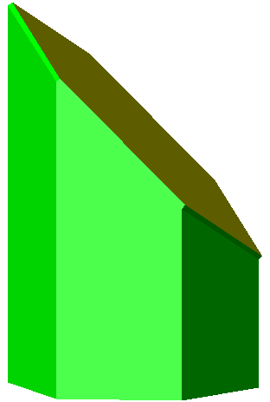
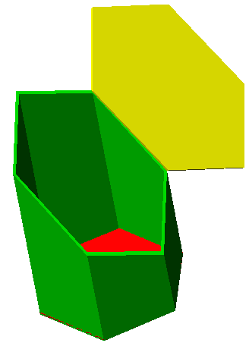
Truncated Prism
4
3
5
2
3,E
2,F
6
1
4,D
TS
1,A
H
D
A
C
B
F
5,C
6,B
5
4
6
4
4
5,3
5
3
6,2
6
2
1
TL
1
1
1
4
5
D
C,E
B,F
A
A
B
C
D
E
F
A
TS
6
A
D
3
F
2
1
A
F
E

Slide 4
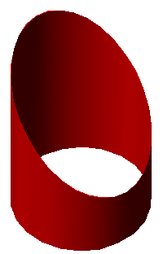
Approximate Developments: Truncated Cylinder
Layout the base & then vertical TLs
5
4
3
6
2
7
1
Attach base and top surface (in True Shape), only if the object is inclusive of top and base
8
12
9
11
10
H
F
7
6,8
9,5
11,3
1
1
2
3
4
5
6
7
8
9
10
11
12
1
4,10
2,12

Slide 5
A₁
F₁
Truncated Right Pyramid
E_{T}
F_{T}
E₁
K_{T}
L_{T}
N₁
L₁
D_{T}
M_{T}
O_{T}
N_{T}
A_{T}
D₁
J_{T}
H_{T}
K₁
C_{T}
B_{T}
M₁
C₁
O_{F}
J₁
O₁
H₁
M_{F}
B₁
J_{F}
J₁
H_{F}
N₁
H₁
A₁
Find TL of all truncated edges on developed surface
Line ON is seen in TL in FV:Mark TL of ON on
developed surface on bend line OA
To get OH in TL:Rotate OH so that it is parallel
to hinge line and project it in FV-Repeat OJ, OK, OL
Transfer these on the developed surface
N_{F}
D_{F}
E_{F},C_{F}
F_{F},B_{F}
A_{F}

Slide 6
Development of a Truncated Cone
11
10
9
10
12
8
9
11
7
8
T
12
1
R
T_{I}
6
O_{T}
S_{I}
R_{I}
7
S
1
5
6
2
4
5
3
T_{I}
3
4
O₁
O_{F}
R_{I}
2
S_{I}
1
T₁
T_{F}
R₁
R_{F}
S_{F}
7
3,11
2,12
1
Attach base and top surface (in True Shape), only if the object is inclusive of top and base

Slide 7
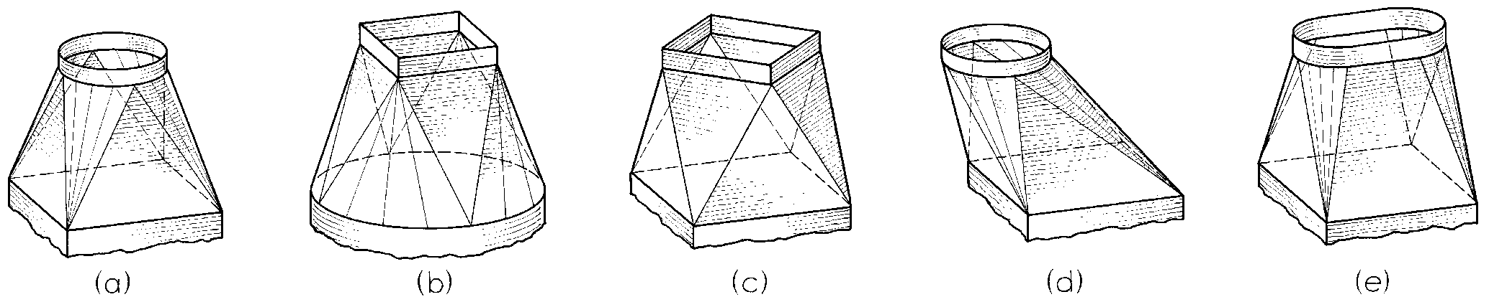
Development of Transition Pieces
Plane Surface
Curved/Conical Surface

Slide 8
Developing Transition Pieces: Openings with Different Shape of Cross Sections
By Triangulation
9
11
10
8
3
2
4
7
5
1
6
8
6
12
7
12
5
9
4
3
5
4
3
2
1
1
8
1
2
11
6
7
8
8
2
11
9
10
9
10
12
10
TRUE LENGTH DIAGRAM

Slide 9
Thank You !!!

